Slide 1
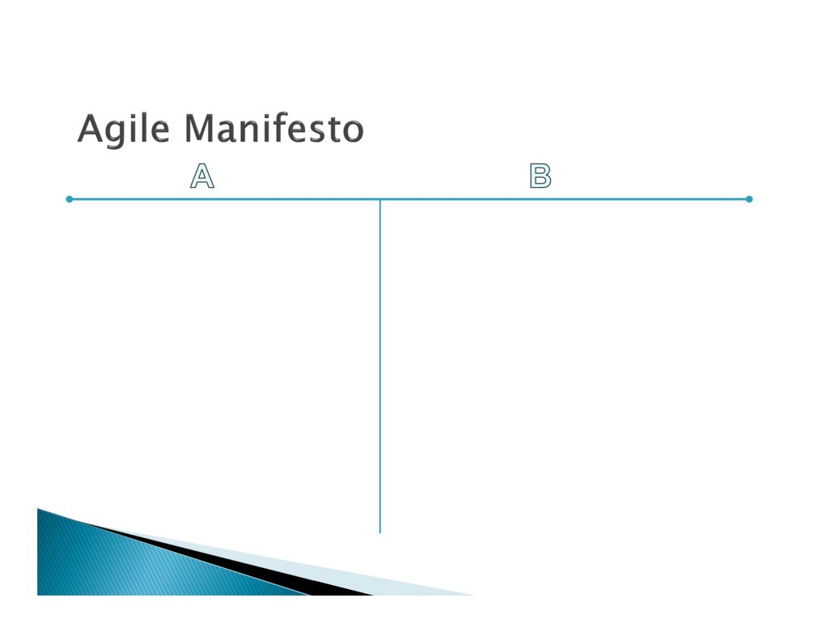
Individuals and interactions | over | processes and tools
Working software | over | comprehensive documentation
Customer collaboration | over | contract negotiation
Responding to change | over | following a plan
That is, while there is value in the items on the right, we value the items on the left more.
(PMI®-ACP) Agile Certified
Practitioner

Slide 2
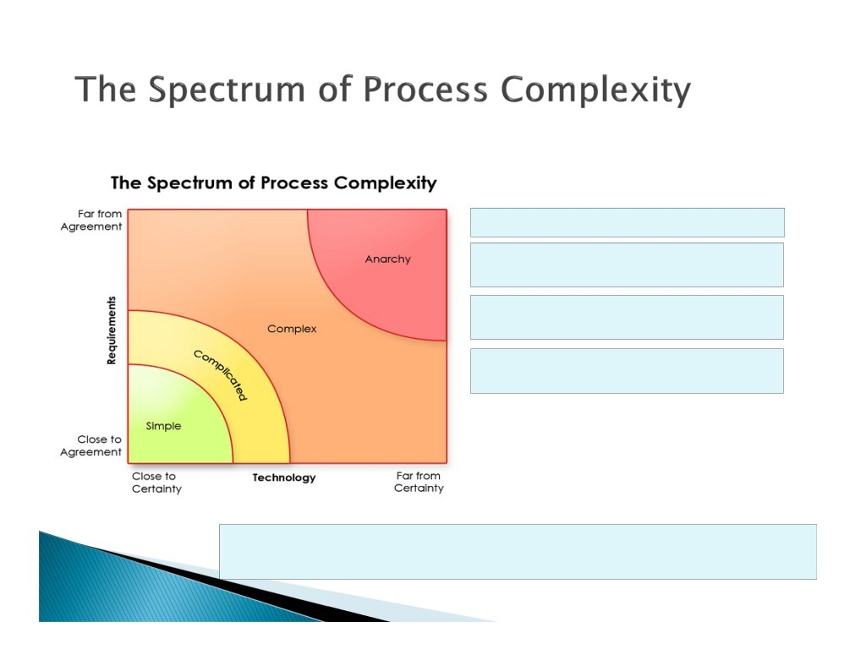
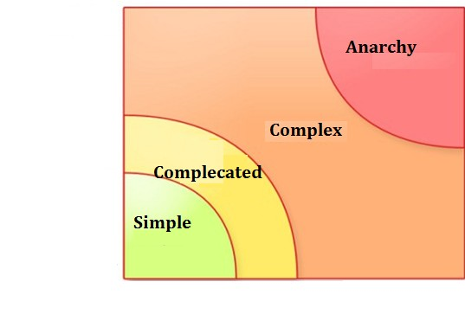
Far from Agreement
Simple = easily knowable.
Complicated = not simple, but still knowable
Complex = not fully knowable, but reasonably predictable.
Chaotic = neither knowable nor predictable
Requirements
Close to Agreement
Close to Certainty
Technology Far from Certainty
When you manage a system, you need to know whether it is either predictable or complex.
If you take the wrong approach to building or managing such a system,
you’re either blow-drying your pizza, or microwaving your dog
(PMI®-ACP) Agile Certified
Practitioner

Slide 3
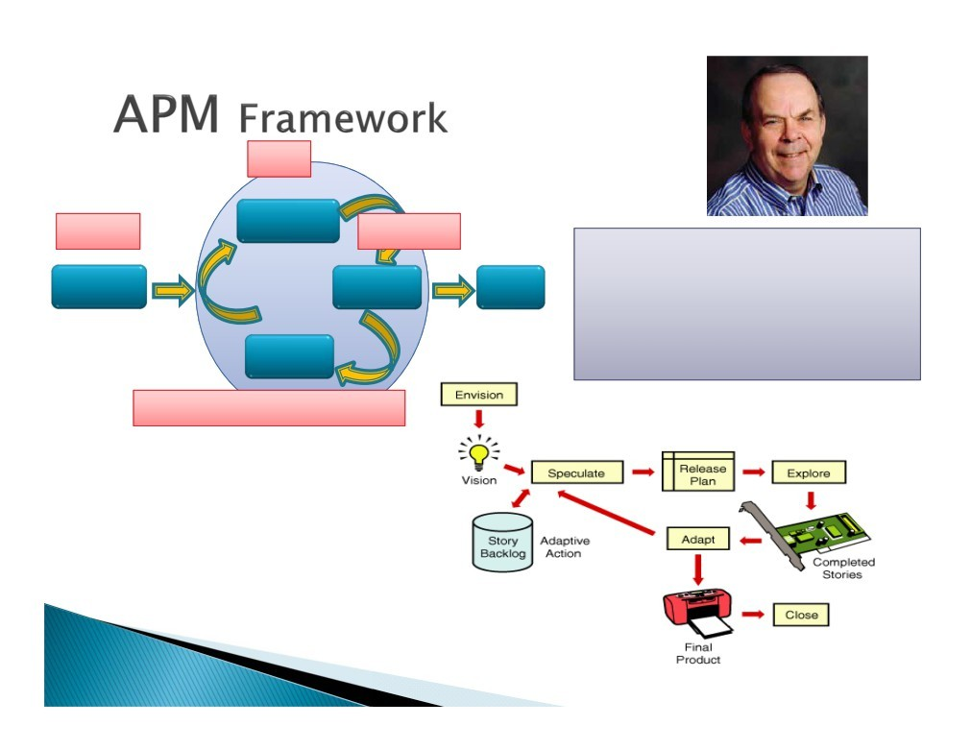
Plan
Initiate
Envision
Speculate
Execute
Explore
Mr. Jim Highsmith
Coauthor : Agile Manifesto, Declaration of Interdependence for project leaders Author: Adaptive Software Dev. (Jolt Award 2000), APM Framework
Founding Member : Agile Alliance, Agile Project Leadership Network
Current: Director of “Cutter Consortium”
Close
Adapt
Monitoring and Control
(PMI®-ACP) Agile Certified Practitioner

Slide 4

(PMI®-ACP) Agile Certified Practitioner

Slide 5
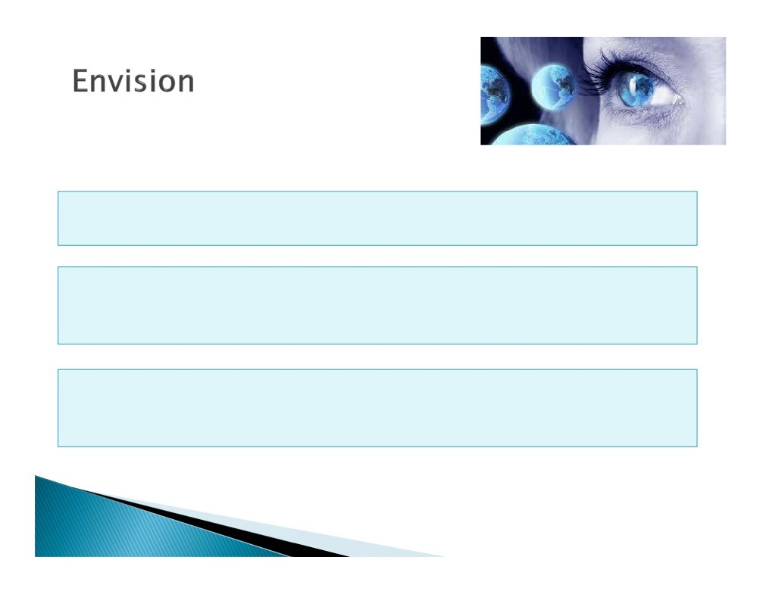
This session will cover all activities perform in Envision Phase of APM framework.
The Initial Phase of Project Management, in which Key members are involved and collaborate to create the compelling vision of project.
Determine the product vision and project objectives and constraints, the project community, and how the team will work together
(PMI®-ACP) Agile Certified
Practitioner

Slide 6
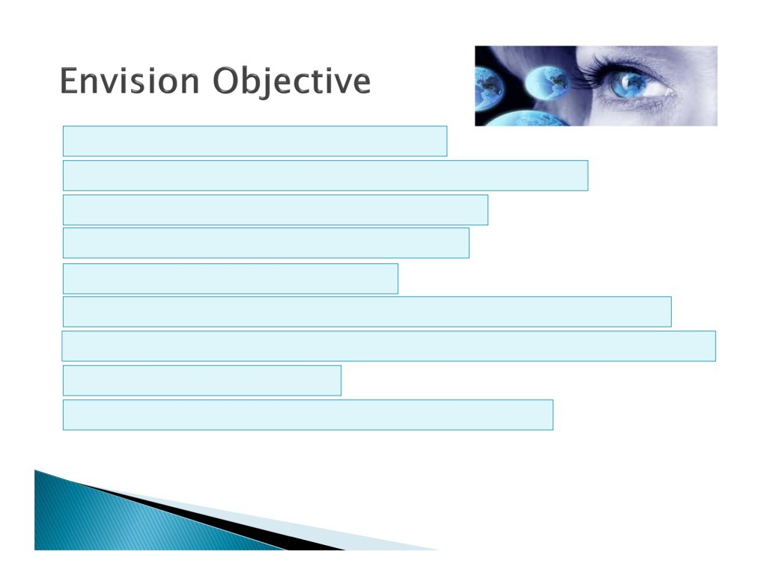
What is the customer's product vision?
What are the key capabilities required in the product?
What are the project's business objectives?
What are the project's quality objectives?
What is the scope of this project?
What are the project constraints (Scope, Resource, Schedule, Quality, Cost)?
Who are the right participants to include in the project community?
What are the project’s risk?
How will the team deliver the product (approach)?
(PMI®-ACP) Agile Certified
Practitioner

Slide 7
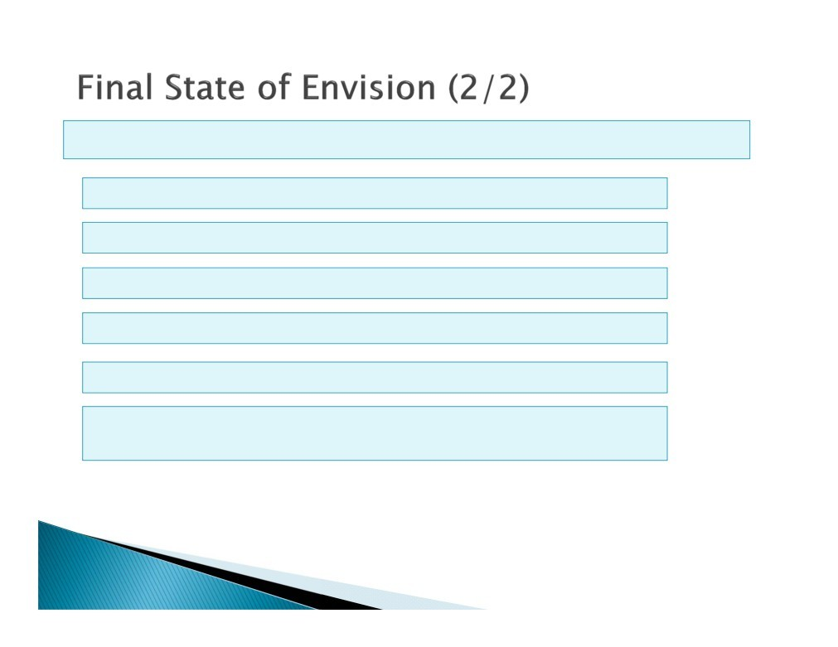
We receive followings at the end of this Phase
Understood the vision of the project
Team learn the Scope at high level
Identified the Risk at this stage and approach to handle
Key Capabilities to deliver (Technical and Non Technical)
Identified the Stake Holders (Pigs & Chicken)
Identified the approach to deliver (Team Structure, Methodologies, Process)
(PMI®-ACP) Agile Certified
Practitioner

Slide 8
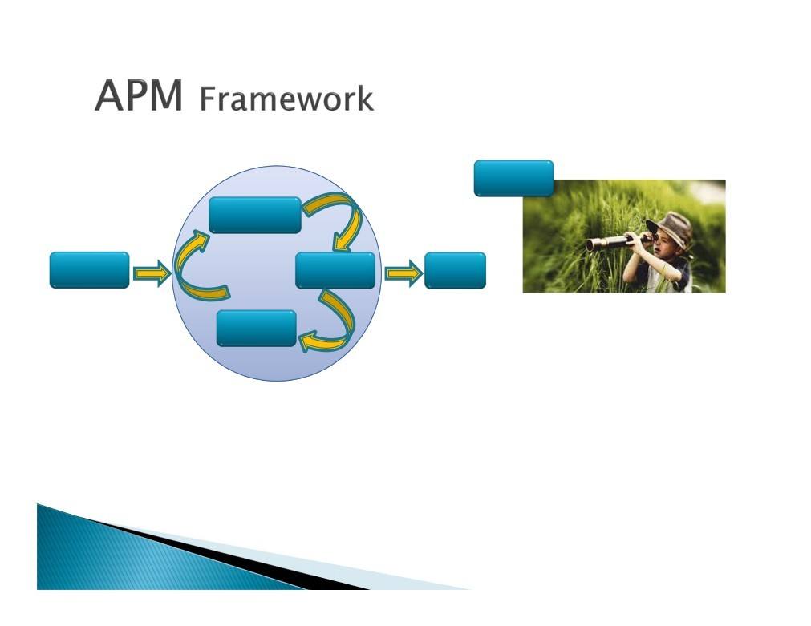
Envision
Speculate
Envision
Explore
Close
Adapt
(PMI®-ACP) Agile Certified
Practitioner

Slide 9
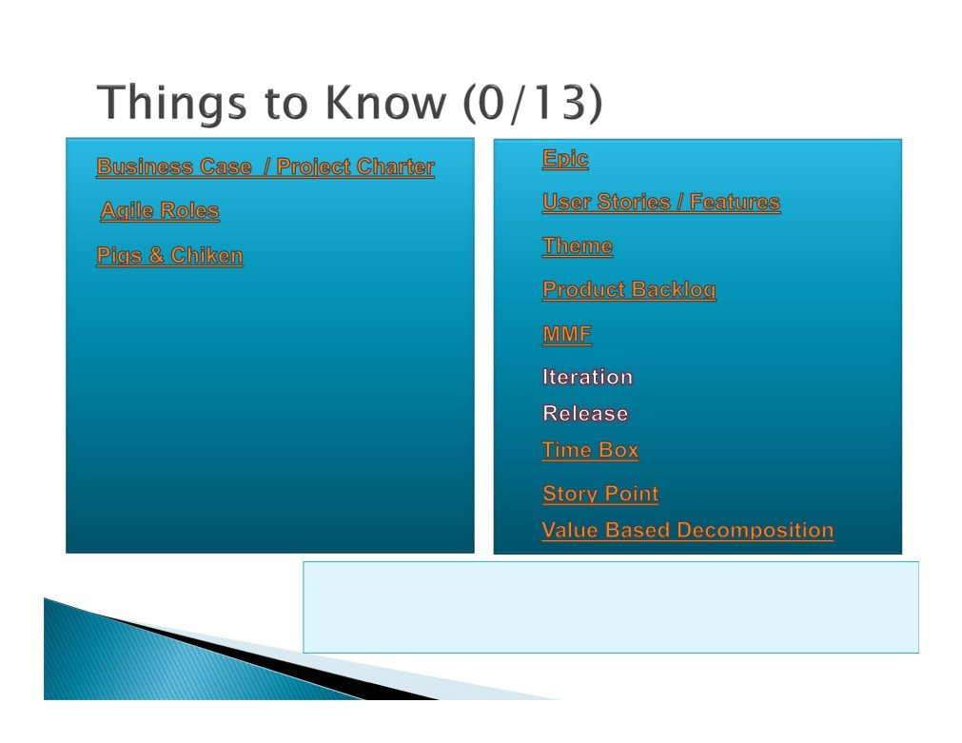

Business Case / Business Charter Agile Roles
Pigs & Chicken
Epic
User Stories / Features Theme
Product Backlog MMF
Iteration Release Time Box Story Point
Value Based decomposition
Note:
While the terminology varies--Scrum for instance has a
“product backlog”, FDD
a “feature list” and DSDM a “prioritized requirements list”-
Note:
While the terminology varies--Scrum for instance has a “product backlog”, FDD a “feature list” and DSDM a “prioritized requirements list”-
(PMI®-ACP) Agile Certified Practitioner

Slide 10
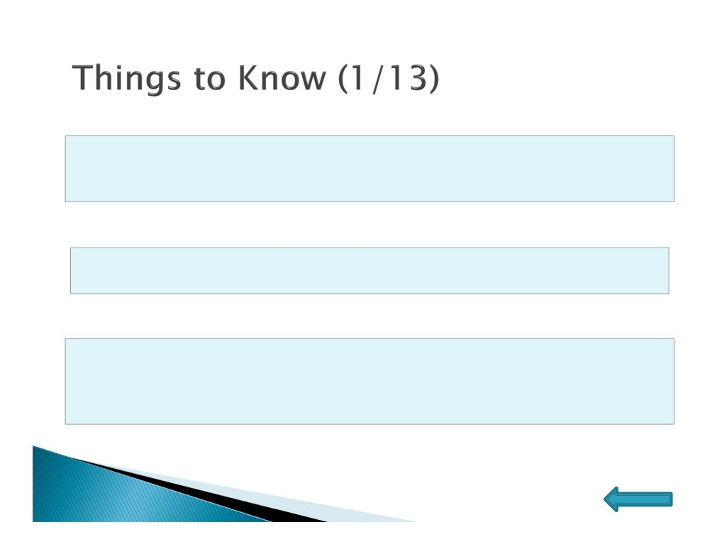
➢Business Case
A business case is an argument, usually documented, that is intended to convince a decision maker to approve some kind of action. The document itself is sometimes referred to as a business case.
➢Project Charter
A project charter (PC) is a document that states a project exists and provides the project manager with written authority to begin work.
➢User Story
User stories are short, simple description of a feature told from the perspective of the person who desires the new capability, usually a user or customer of the system. They typically follow a simple template:
As a <type of user>, I want <some goal> so that <some reason>.
(PMI®-ACP) Agile Certified
Practitioner
Home

Slide 11
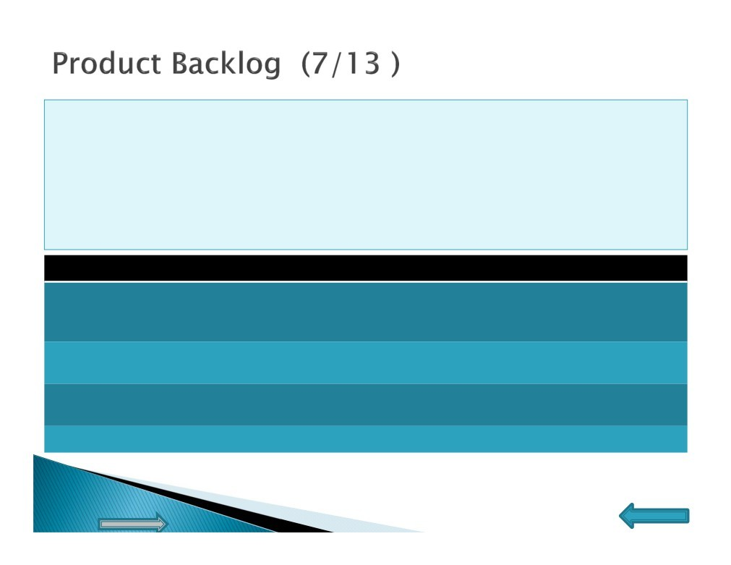
The Product Backlog is a list of planned functionalities of the Project, sorted by value to customer (High to Low)
Owner : Customer
Grooming: Addition and clean up of completed stories, this practice is known as Grooming.
Product Backlog should be “DEEP”
Acronym “D”
Expanded Form
Detailed Appropriately
Estimable
Emergent Prioritized
Description
User stories should contain neither too more nor too little details. Enough Value for the team to
deliver. (Expected to clarify doubt)
Stories should have enough details to estimate story points or ideal days (Effort)
It is not static, it grows and changes over the time
Most Values User stories should be at the Top
“E”
“E”
“P”
(PMI®-ACP) Agile Certified
Practitioner
Home
End

Slide 12
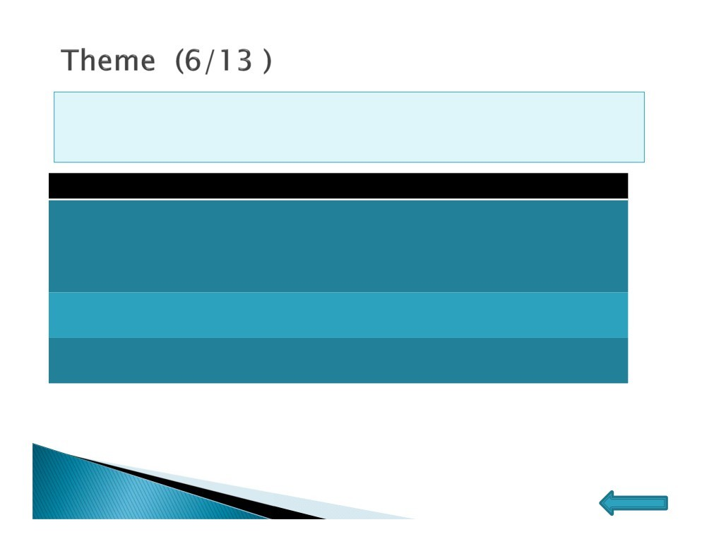
 Themes, on the other hand are just a broad way of describing an area of focus. Each theme would probably contain several epics or many user stories.
Theme Stories Under Theme Job Search
1) I want to search for a job, so that I can find my next career
move
2) I want to search job in two different ways i.e. Basic Search & Advance search, so that I can use it appropriately to save time.
XXXX
XXXX
XXXX
XXXX
Apply for Job
CV
Database
(PMI®-ACP) Agile Certified
Practitioner
Home

Slide 13
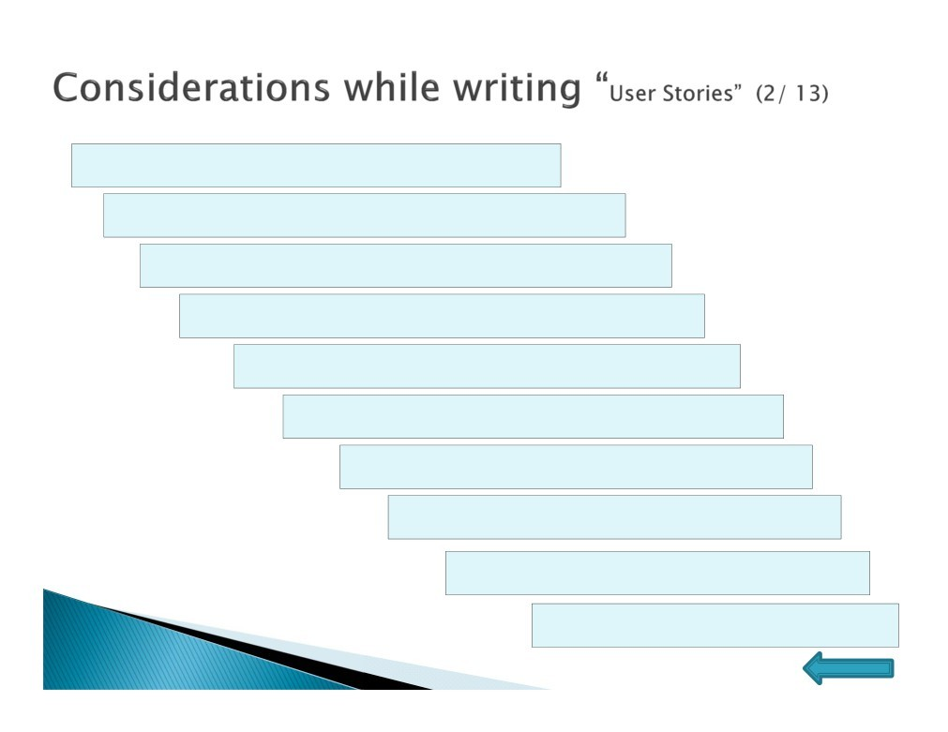
 Customer focused
 Domain experts write user stories
 Use the simplest tool
 Write it in simple language
 Include unique story number
 Include the Priority number
 Indicate the estimated size
 Testable
 Independent
 Achievable
(PMI®-ACP) Agile Certified Practitioner
Home

Slide 14
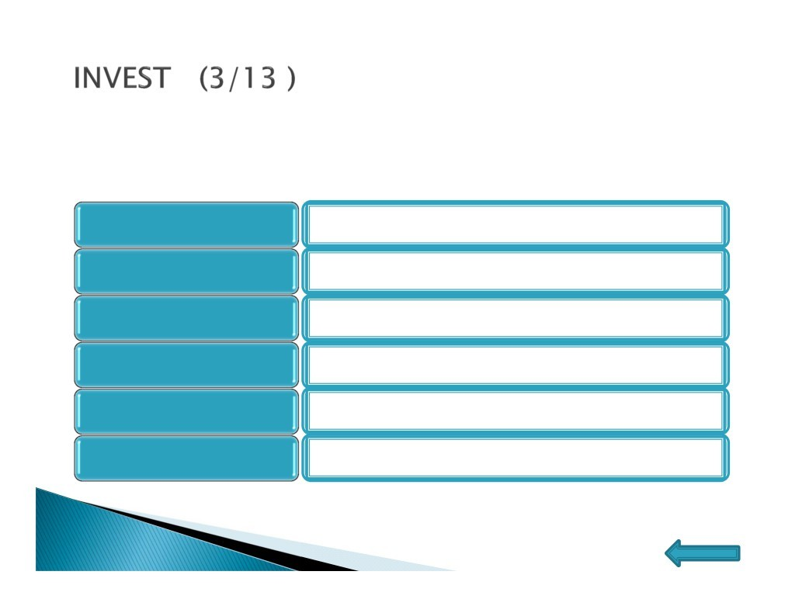
Well-defined “user story” follows INVEST model
I - Independent
The user story should be self-contained.
N - Negotiable
The user stories can always be changed and re-
written.
An user story must deliver value to the end user.
V - Valuable
E - Estimateable
Must be always able to estimate the size of user
story.
S - Small-sized appropriately
User stories should be small enough to
plan/task/prioritize with a level of certainty.
Must provide necessary information to make test
T - Testable
development possible.
(PMI®-ACP) Agile Certified
Practitioner
Home

Slide 15

INVEST - Exercise
Does the story overlap with any other story? | Independent
Will it be possible to verify that the story has been completed | Testable
Is the functionality described in the story beneficial to the customer? | Valuable
Will the story take more than a week to develop? | Small
Does the story capture just the essence of what’s required? | Negotiable
Is it possible to determine how much effort it will take to develop the story? | Estimable

Slide 16
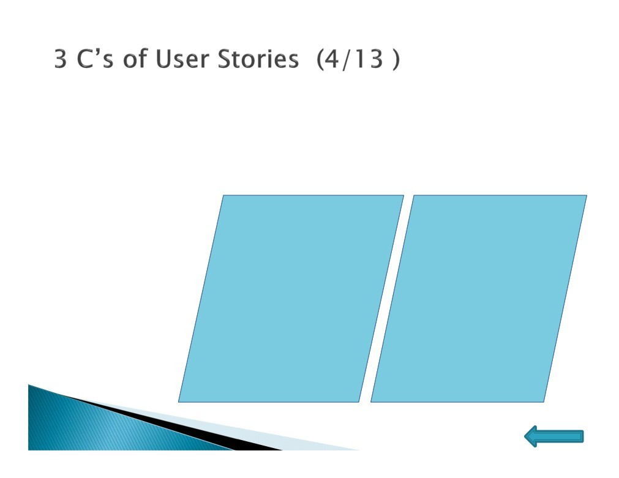
➢Card ➢Conversation ➢Confirmation
Front side
Back side
Confirmation:
Payment should happen before purchasing the question paper
Question paper available for different subjects
Any number of question papers can be purchased by a student
As an end user I want to purchase the model question paper so that I can avoid delay in purchase
Priority : 9
Estimate : 7
(PMI®-ACP) Agile Certified
Practitioner
Home

Slide 17


User Stories
Every User Story has 3 parts
The 3 C’s: Card, Conversation, Confirmation
As a Customer who has booked a flight
I want to cancel my booking
So that I can get a refund and make other plans
17

Slide 18
The 2nd C: Conversation
The card does not include all the detailed information needed
by the Dev Team
– and this is intentional!
User Stories are designed to force a conversation between the Dev Team and Product Owner
We want to make it impossible for the Dev Team to start work on a User Story until they have had a detailed
conversation with the Product Owner
The conversation begins at the start of the project
The Dev Team and Product Owner will talk through the entire Product Backlog of User Stories at the project kickoff
The conversation continues Iteration-by-Iteration
In Iteration Planning and also during the Iteration
We get to choose how to document the conversations
18

Slide 19


The 3rd C: Confirmation
During the conversations, the PO and Dev Team identify the confirmations for each User Story
These are typically acceptance tests that must be passed
The Dev Team uses these as a guide to development, and as a way of confirming that the requirements have been met
Verify that the ticket price minus applicable cancellation fee is refunded to the credit card
Verify that 10% cancellation fee is deducted
Verify no fee is deducted for business class
Verify that a confirmation email is sent
Verify that the seat reservation is released
As a Customer who has booked a flight
I want to cancel my booking
So that I can get a refund and make other plans
19

Slide 20
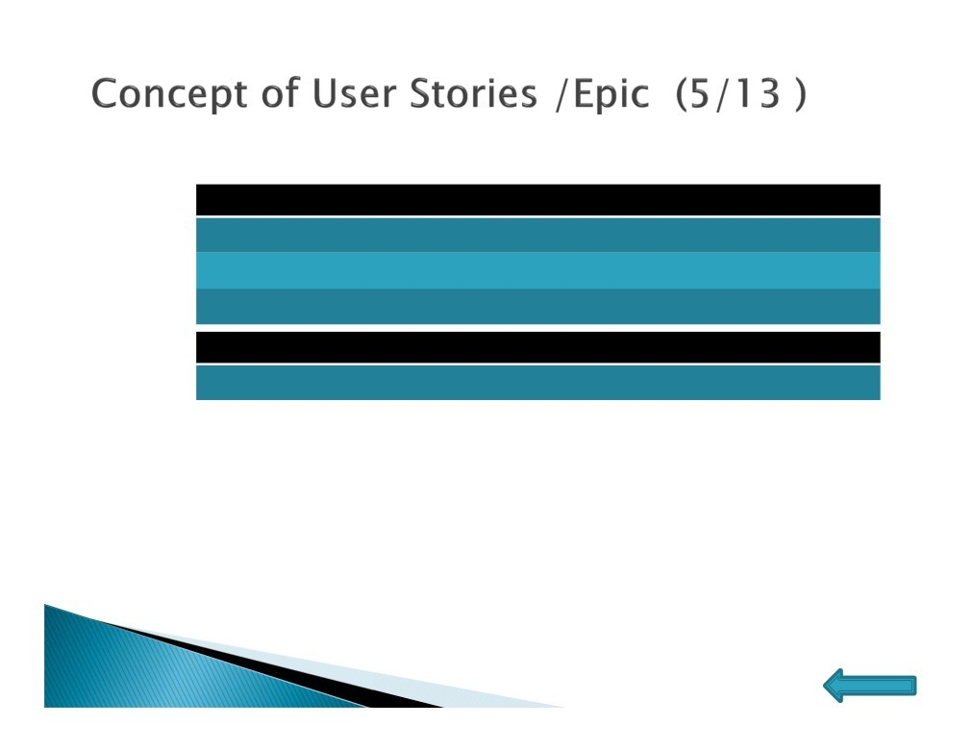
 Format of Epic User Stories
Example → As a [role] I Want to do [feature] so that I can do [reason/benefit] As an end user
I want to search for a job,
so I can find my next career move
It is actually in the format of [who] [what] [why] [Why] is optional, but it is better to describe it
 User Stories:
Standard Job Search Advance Job Search
Note: A user Stories contain many features Ex:
Back-end development of the search index
Front-end development of the search box
An API to find the most relevant search results
Front-end development of the results page, writing test cases
Executing the tests, configuring the search servers
 Types of User Stories
 Business User Story, Technical User Story, Bug User Story
(PMI®-ACP) Agile Certified
Practitioner
Home

Slide 21
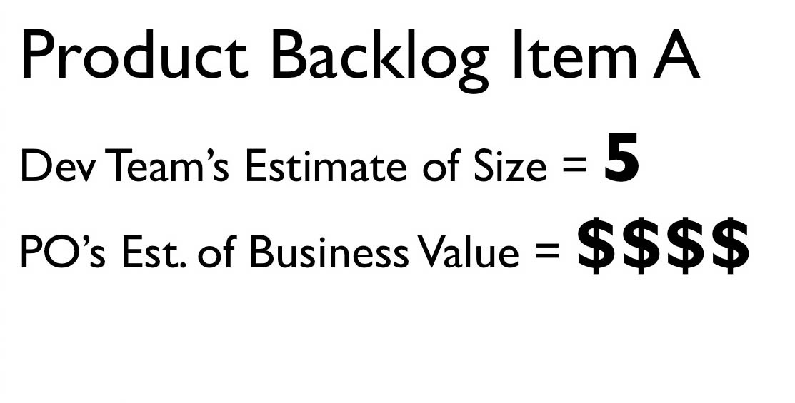
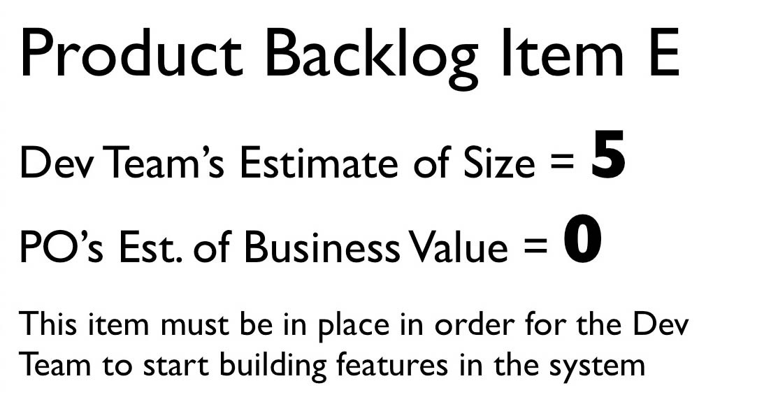
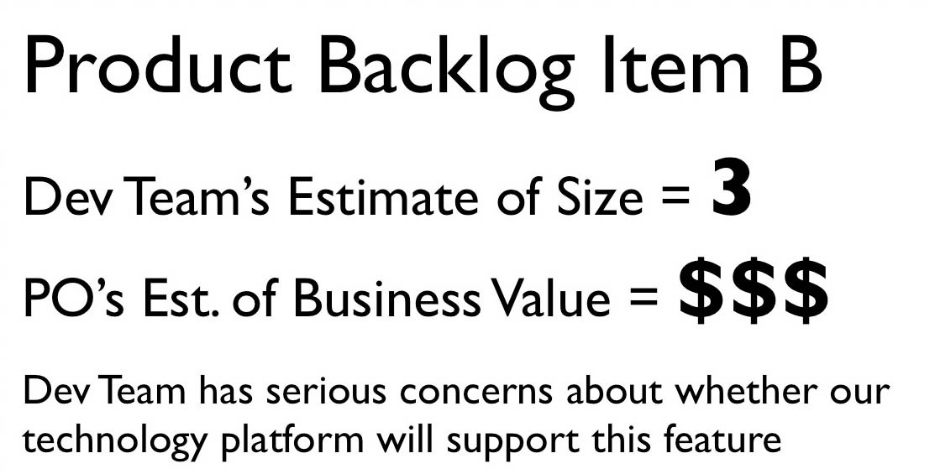
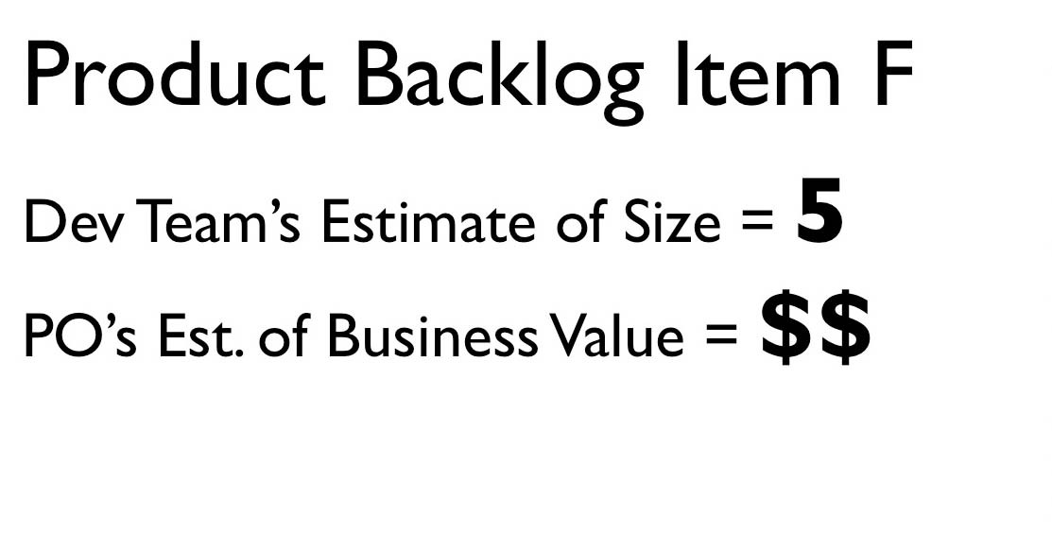
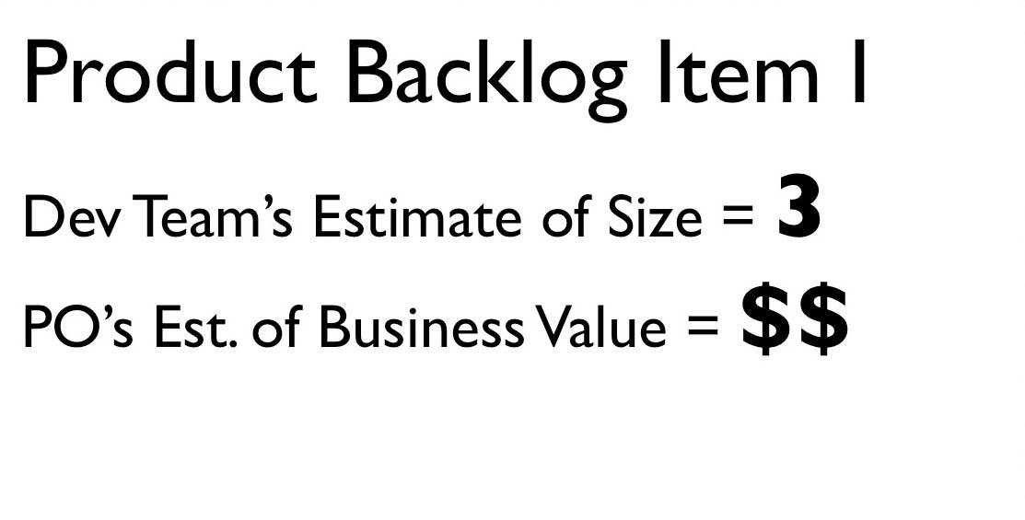
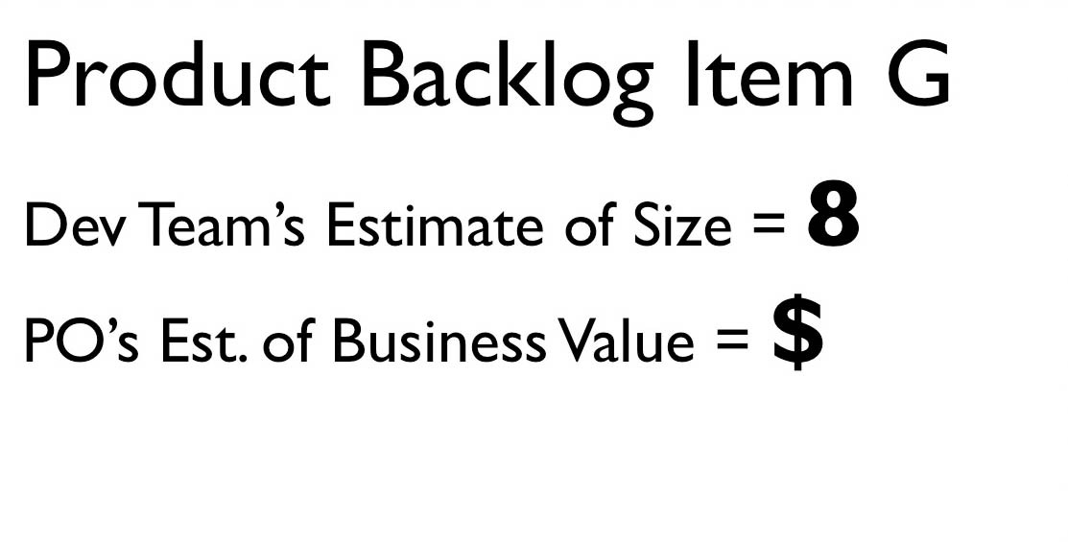
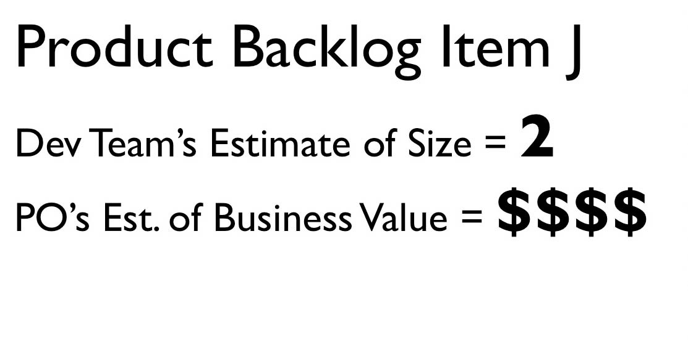
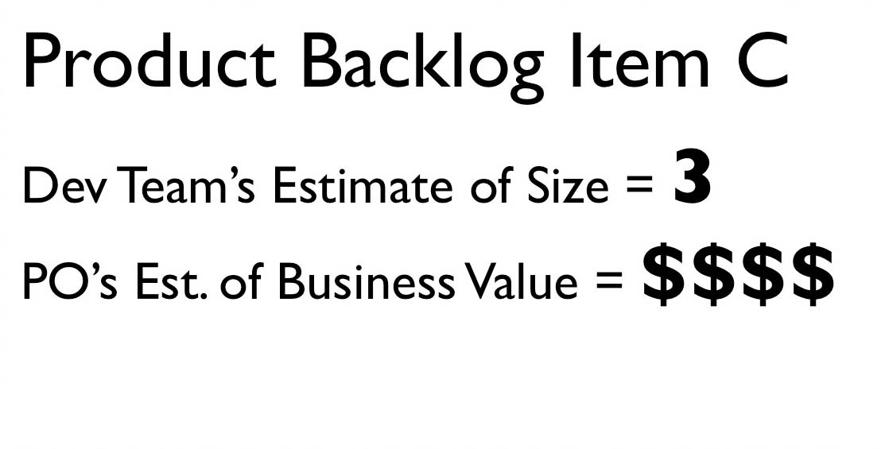
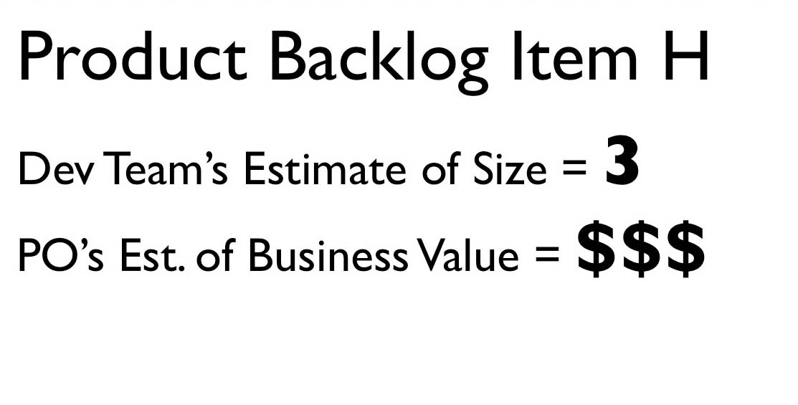
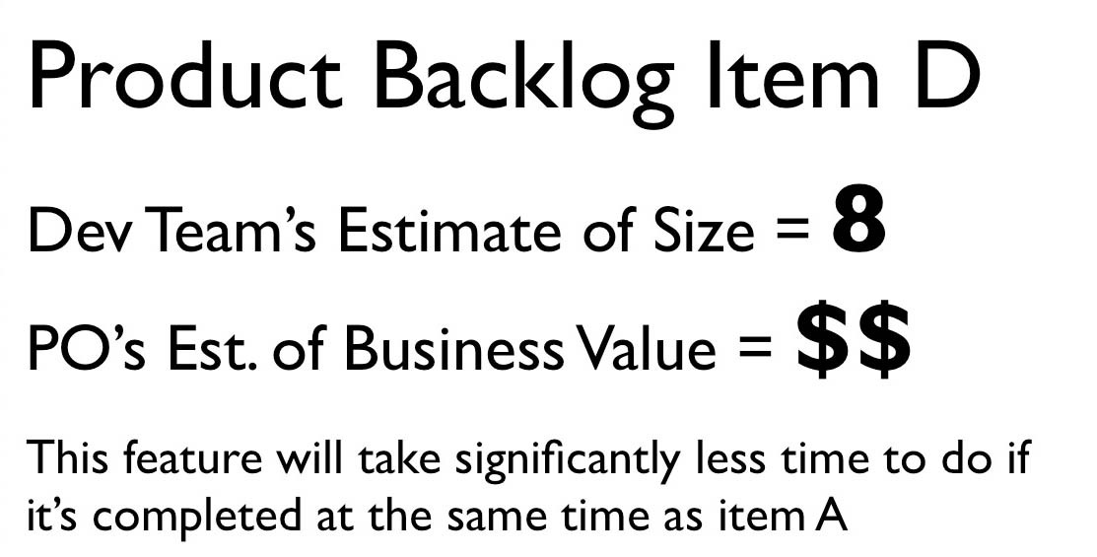
67

Slide 22
68

Slide 23
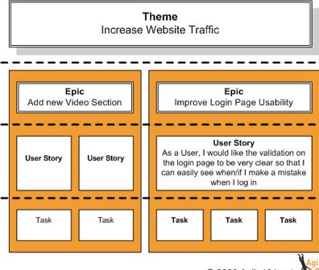

Slide 24
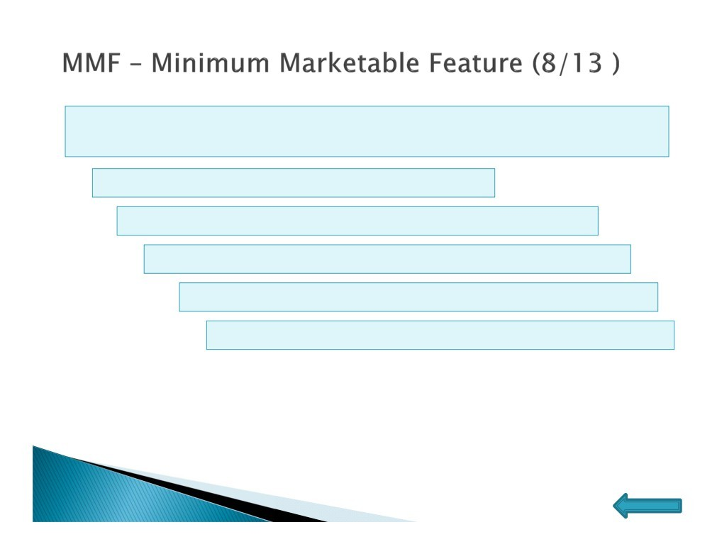
MMF is the basic minimum feature of the product so that people can start using it rather than waiting for something else
There will be a release after MMF
It can contain single or combination of user stories
It enables incremental delivery of the product
Multiple MMF makes whole product
Each MMF has value to end user on its own
(PMI®-ACP) Agile Certified
Practitioner
Home

Slide 25
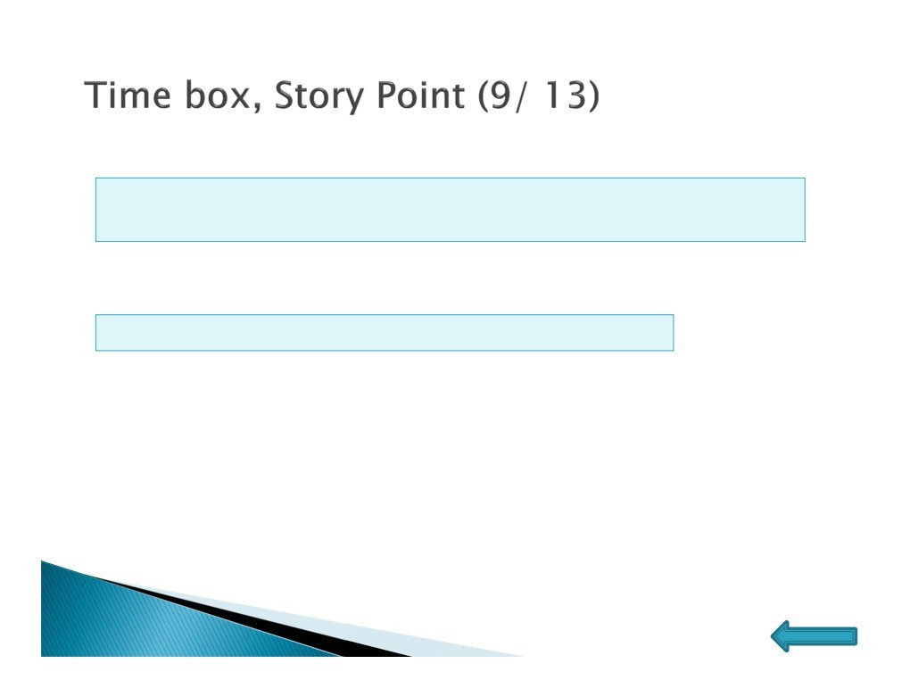
➢Time Boxing
Time boxing is a realistic estimate or expectation of how long an action, task or event will take to perform.
➢Story Point
A fixed and relative value of a development effort.
(PMI®-ACP) Agile Certified
Practitioner
Home

Slide 26
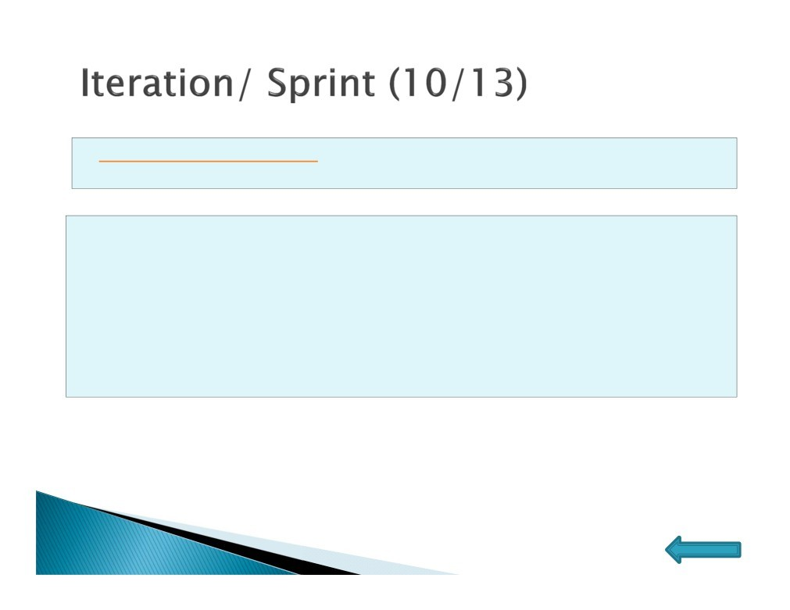
In agile software development, an iteration is a single development cycle, usually measured as one week or two weeks.
•Estimating and Planning (4+1)
Define clear goals
Everyone (not only the person who are going to develop it) MUST understand the task
Everyone can contribute their way they see is the best
•Daily Scrums (15min every day)
•Demonstration (1h)
•Retrospection - post-mortem (1h)
(PMI®-ACP) Agile Certified
Practitioner
Home

Slide 27
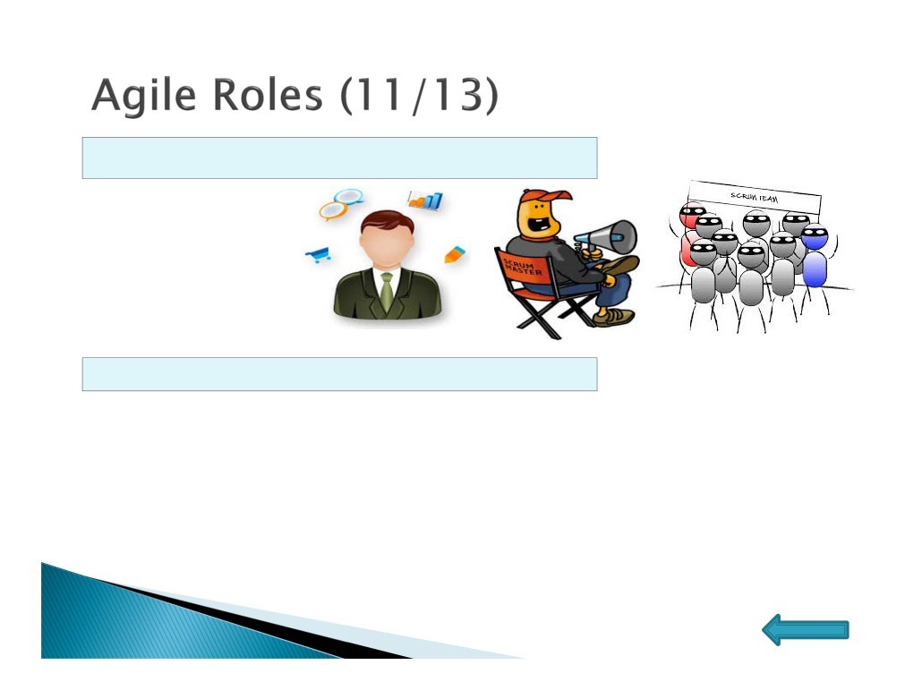
Three basic roles for executing the Scrum project:
▪Product Owner
▪Scrum Master
▪Team
Five basic roles for executing the XP project:
▪Customer
▪Coach
▪Programmer
▪Tester
▪Tracker – Collects the metrics to improve the team’s performance
(PMI®-ACP) Agile Certified
Practitioner
Home

Slide 28
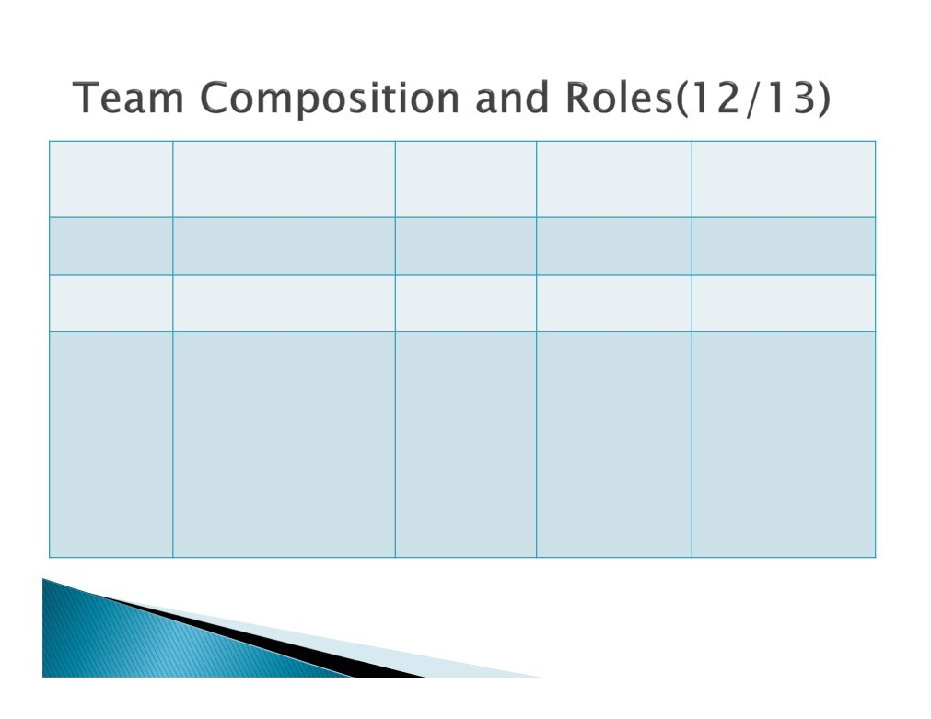
Concept
Generic Agile
XP
SCRUM
DSDM
Nos. of Team
1-6
1 team per project
3 - 16
1 - 4 or more
1 - 6
Team Size
2-10
3 - 9
2 - 6
Team Leader, Ambassador User, [Advisor User],
Product Owner, Agile Project Manager, Technical Lead, Developer, Tester, UX Designer
Business Sponsor, Agile Programme Manager, Architect, Agile Coach
Scrum Team (Experienced Engineer, Junior Engineer, [QA Tester], [Writer]) Scrum master, Product Owner
Customer, Programmer, Tester, Tracker, Coach
Senior Developer,
Developer, Scribe
Roles
Visionary, Executive Sponsor, Project Manager, Technical Co-ordinator, Facilitator
(PMI®-ACP) Agile Certified
Practitioner

Slide 29
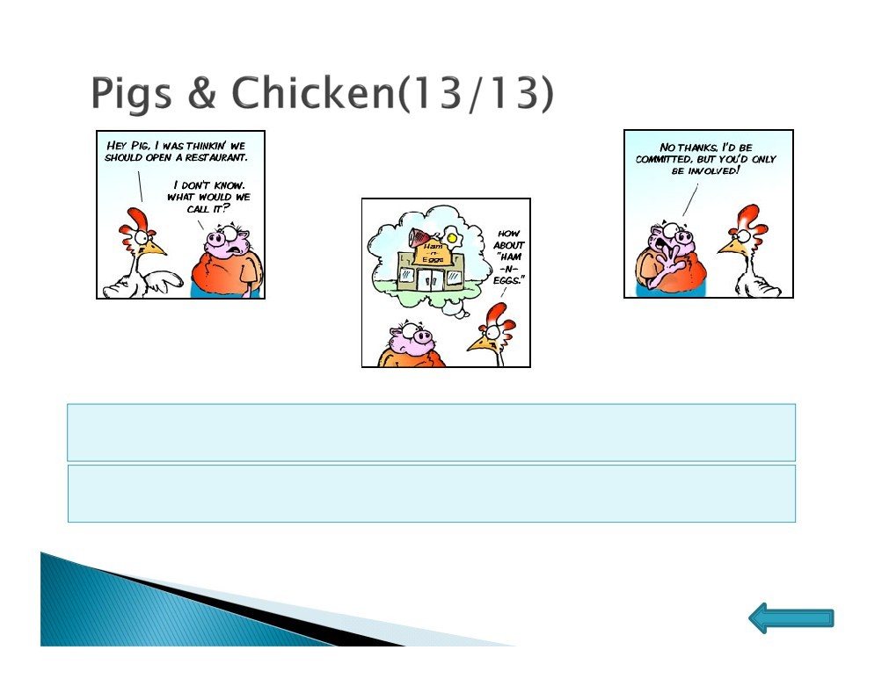
The people who fill the three Scrum roles are those who have
committed to the project (Pigs)
Others might be interested in the project, but they aren’t on the hook (Chickens)
(PMI®-ACP) Agile Certified
Home
Practitioner

Slide 30

(PMI®-ACP) Agile Certified Practitioner

Slide 31
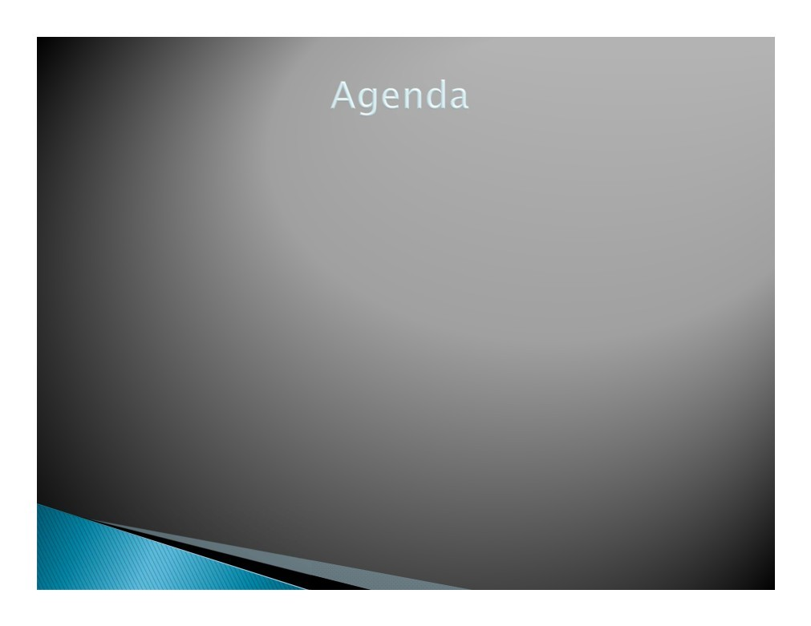
 APM Framework (Speculation)
 Things to Know
 Requirement Gathering
 Organizing Features
 Estimate Requirements
 Accounting Risk
 Risk Adjusted Product Backlog
 Release Plan
 Roadmap
Adaptive Planning
Progressive Elaboration
(PMI®-ACP) Agile Certified
Practitioner

Slide 32
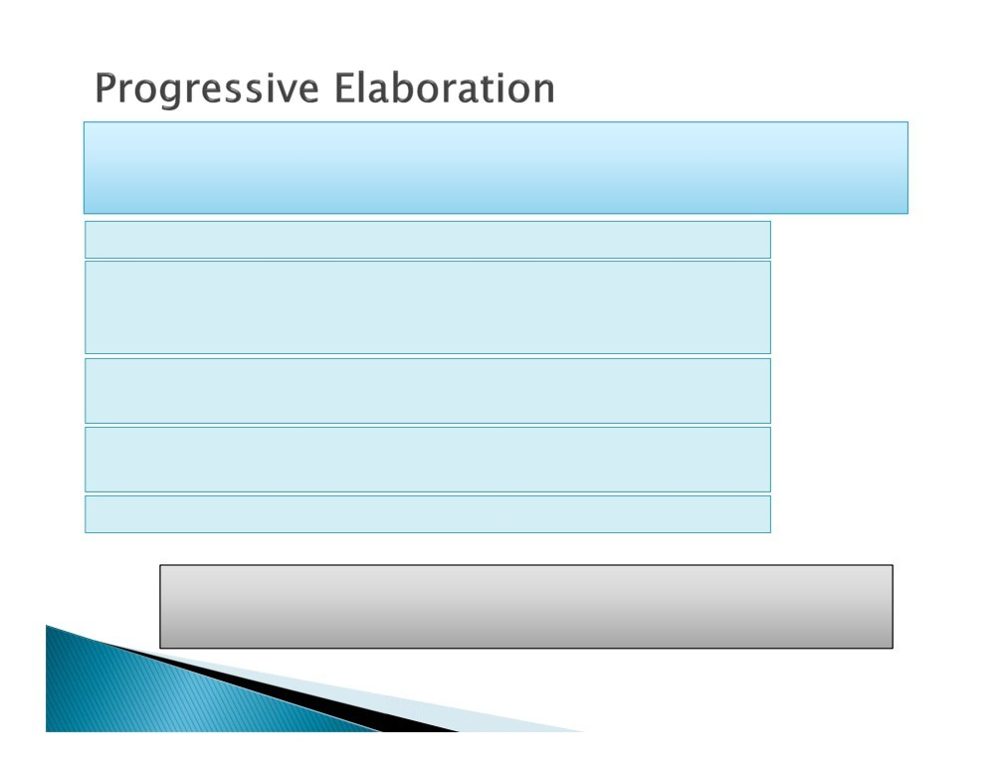
Continuously improving and detailing a plan as more detailed, specific information and more accurate estimates become available as the project progresses.
Decide on a release time-box for the project
Look at the requirements on a high level and have the team decide approximately what you can release in each release cycle. (Less Detailed)
Team discuss requirement in detail in iteration planning meeting with customer before the development work
At the end of the iteration, update the high level overview with any new information that you now have
Repeat steps 3 and 4 for every iteration
Estimate at a high level when the details are not known. Then you
progressively estimate in detail for the current requirements that you are working on. That's basically the idea of rolling wave planning.
(PMI®-ACP) Agile Certified
Practitioner

Slide 33
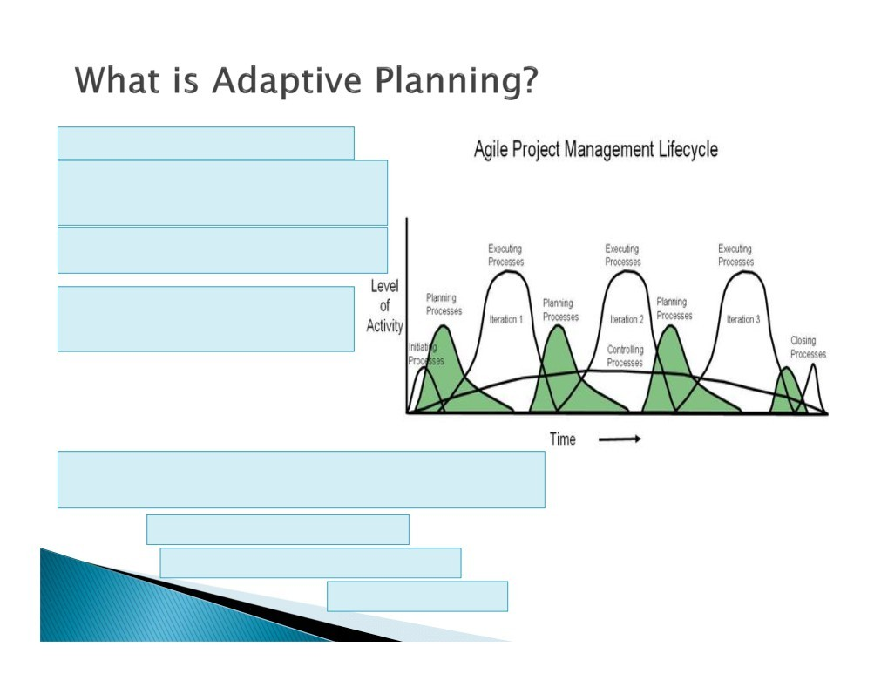
“Rolling wave planning”
Planning for a project is happening in waves as the project becomes clearer and complexities unfold
Focus on adapting quickly to changing realities
Cannot report exactly what task will be done next week but only which features has been planned
Adaptive planning framework occurs in following
three phases:
Release Planning
Iteration Planning
Daily Planning
(PMI®-ACP) Agile Certified Practitioner

Slide 34
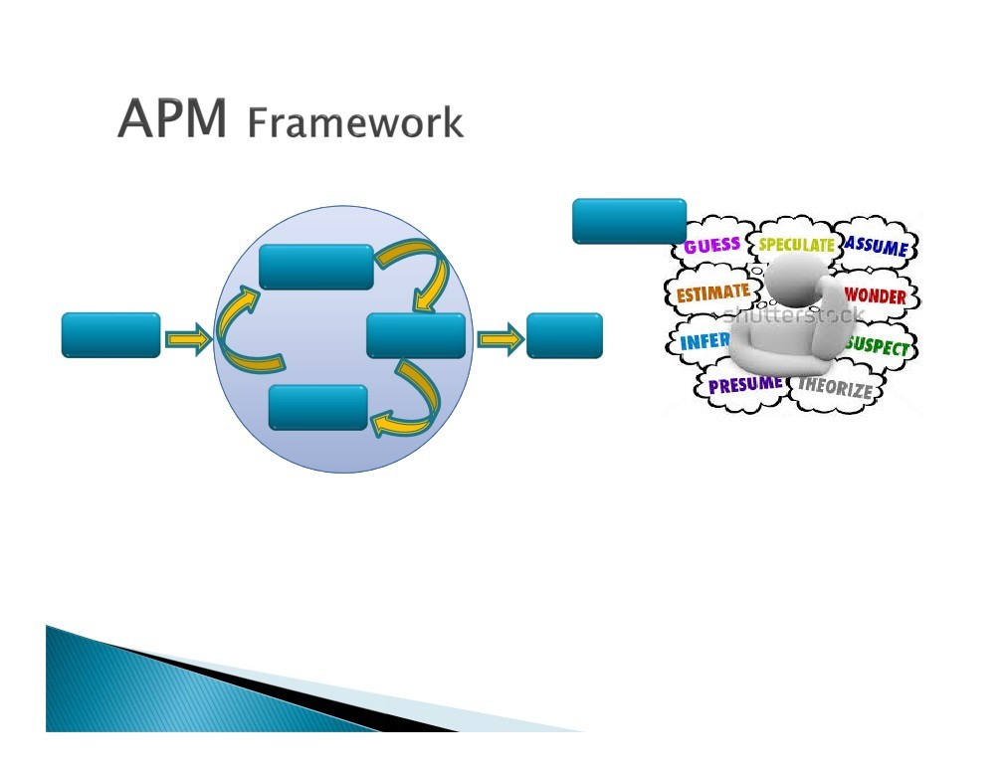
Speculate
Speculate
Envision
Explore
Close
Adapt
(PMI®-ACP) Agile Certified
Practitioner

Slide 35
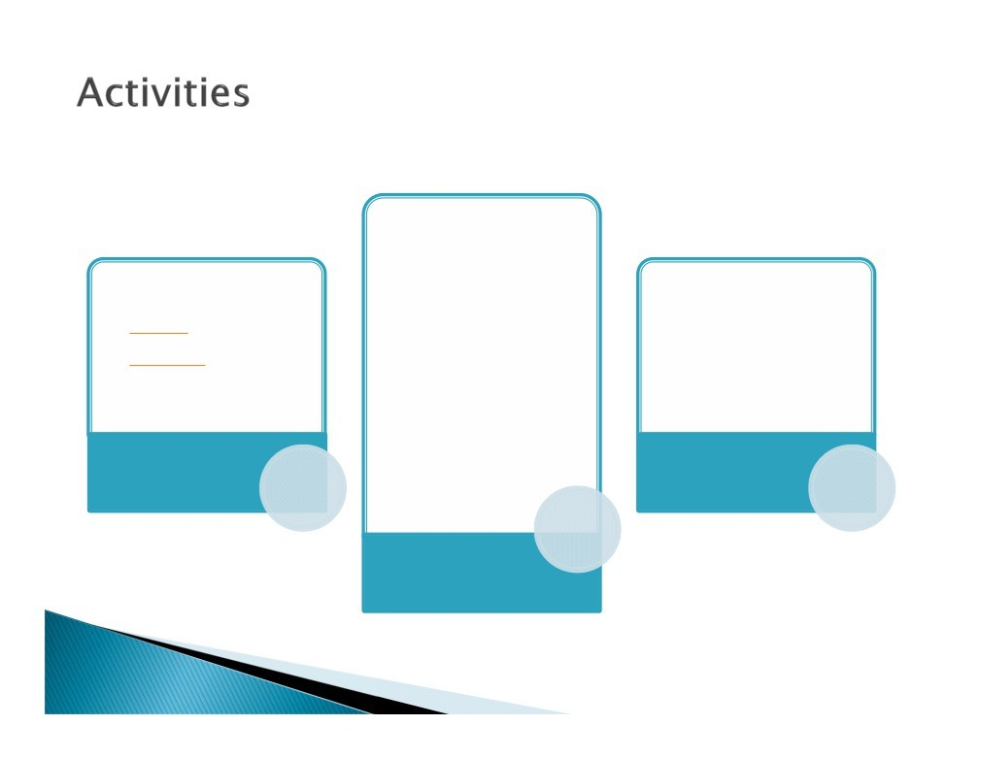
Identify Potential Features
•Specify Categories
By functional Grouping
Business Value
/Priorities and risk
•Ranked in a Single continuous Sequence
Organize Features
Technique used
Model
Persona
Business Use Case
Additional consideration may be taken for the risk associated with certain features.
Requirements Gathering
Accounting Risk
(PMI®-ACP) Agile Certified
Practitioner

Slide 36
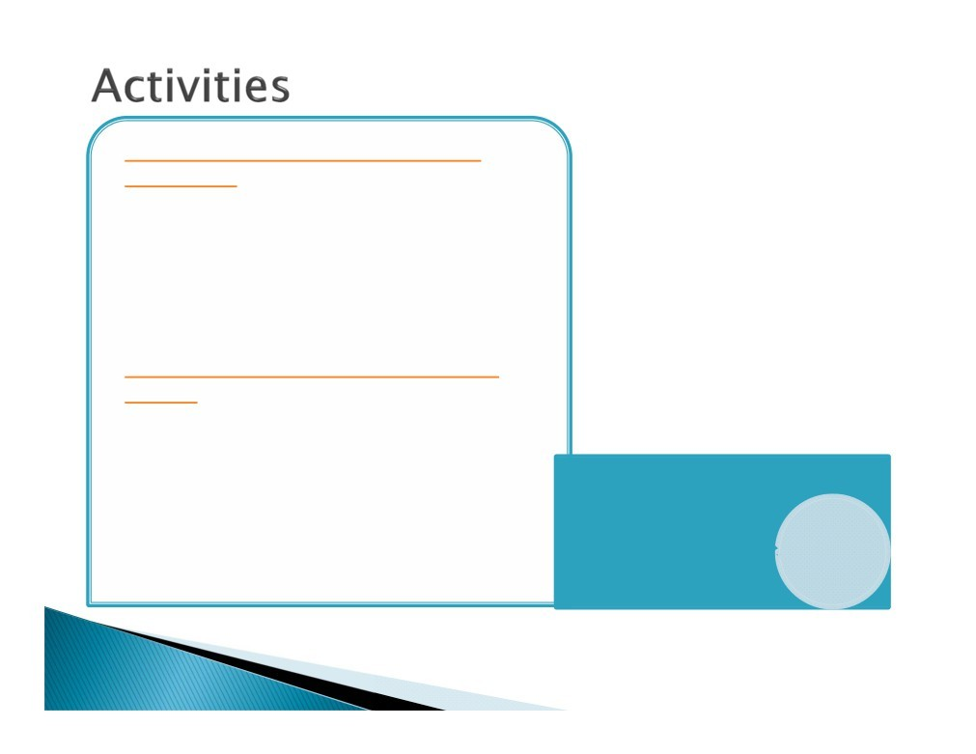
Prioritize Feature using following Technique
Priorities (1,2,3)
High, Medium, Low
MoSCoW (Popularized by DSDM)
KANO
Monopoly Money
Relative Weighing
Collaborate with customer on user stories
Estimate Story Point (using Technique)
Wide Band Delphi
Planning Pokers
Affinity Diagram
Decomposition
Estimate Requirements
(PMI®-ACP) Agile Certified Practitioner

Slide 37

Requirement Gathering Technique
Model
Persona
Business Use Case
(PMI®-ACP) Agile Certified
Practitioner

Slide 38
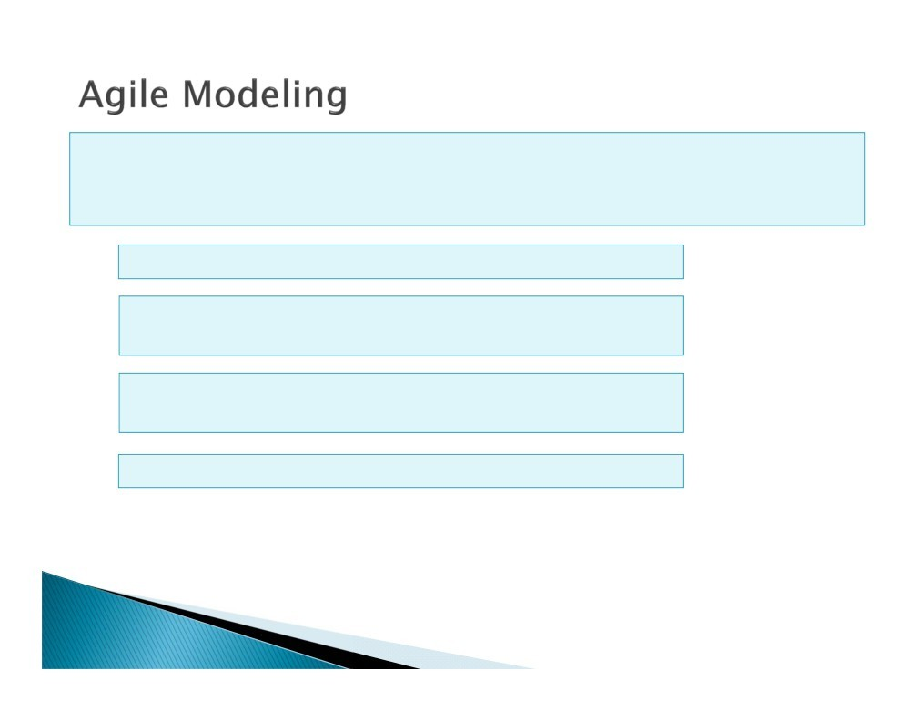
A model or prototype is an original type, form or instance of something serving as a typical example, basis or standard for other things of the same category.
Give users a glimpse of what they might get
More requirements are likely to emerge when users see the prototype
This technique aims to get users to express
requirements
Prototype, USE case, Wireframes, Personas examples of modelling
(PMI®-ACP) Agile Certified
Practitioner

Slide 39
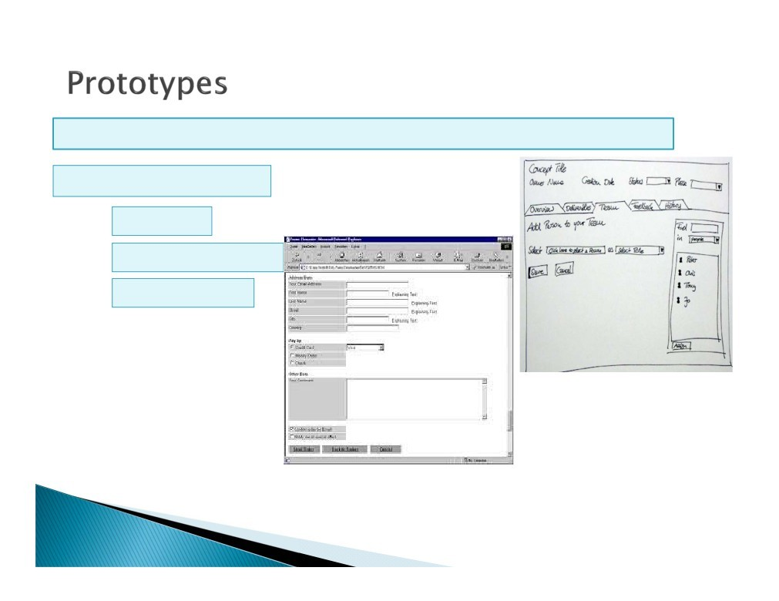
Helps the customer understand current design state
often a working model
How do I interact with this?' or 'How will it be used?'
(PMI®-ACP) Agile Certified
Practitioner

Slide 40
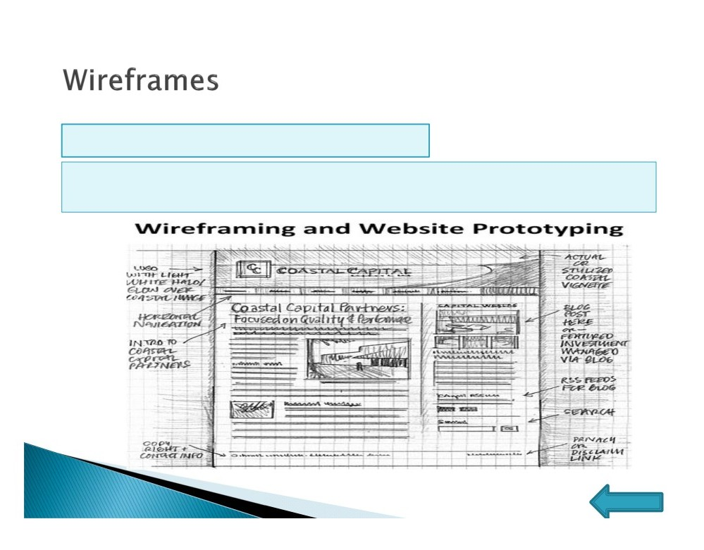
Visual representation 'How does it look?'
Used to substantiate the architecture design and interfacing requirements along with the visual representation
(PMI®-ACP) Agile Certified
Home
Practitioner

Slide 41
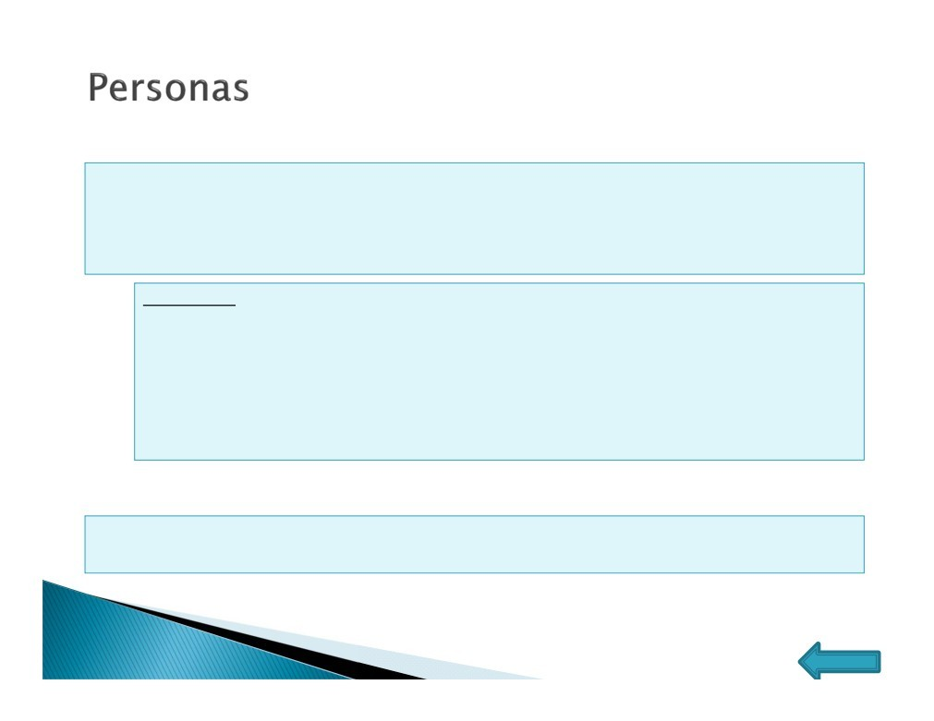
➢Personas
An imaginary person or identity created to model interactions with the system in order to gather requirements. Enhancing your understanding about your customers profoundly and in detail. Personas describe several different types of customers to help bring the idea to life.
Example:
Creating a point of sale system
Persona: “Tylor”
Objective: To represent a user who purchases larger quantities of an item and then return them for credit later that day.
Accessing Flip Cart website
Persona: Teenagers, Age between - 22 to 30, Age above 50
➢Extreme Personas
A team-manufactured process that is strongly exaggerated in order to elicit requirements.
(PMI®-ACP) Agile Certified Practitioner
Home

Slide 42
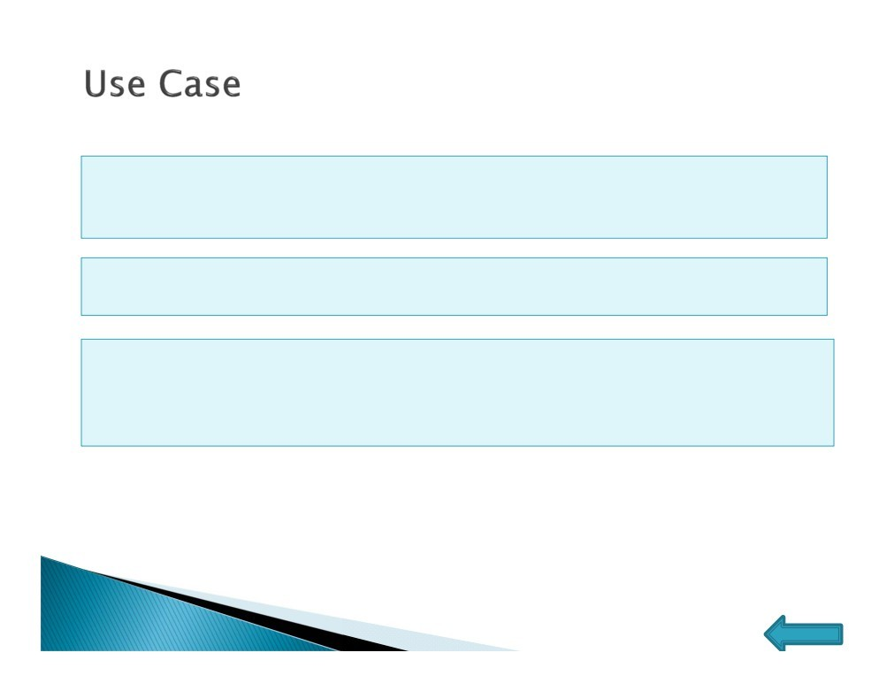
➢Use Case
In software and systems engineering, a use case is a list of steps, typically
defining interactions between a role "actor" and a system, to achieve a goal. Theactor can be a human, an external system, or time
A use case is a methodology used in system analysis to identify, clarify, and organize system requirements
Use cases can be employed during several stages of software development, such as planning system requirements, validating design, testing software, and creating an outline for online help and user manuals.
(PMI®-ACP) Agile Certified Practitioner
Home

Slide 43
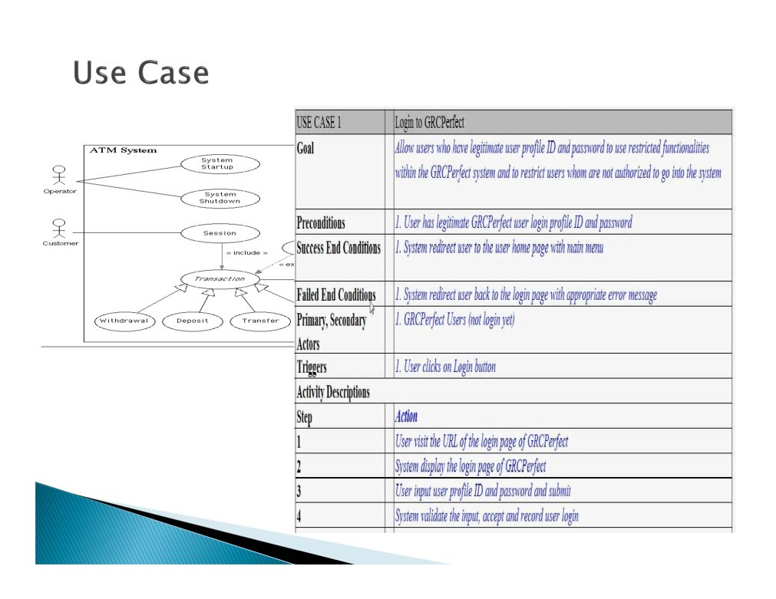
➢Example
(PMI®-ACP) Agile Certified Practitioner

Slide 44
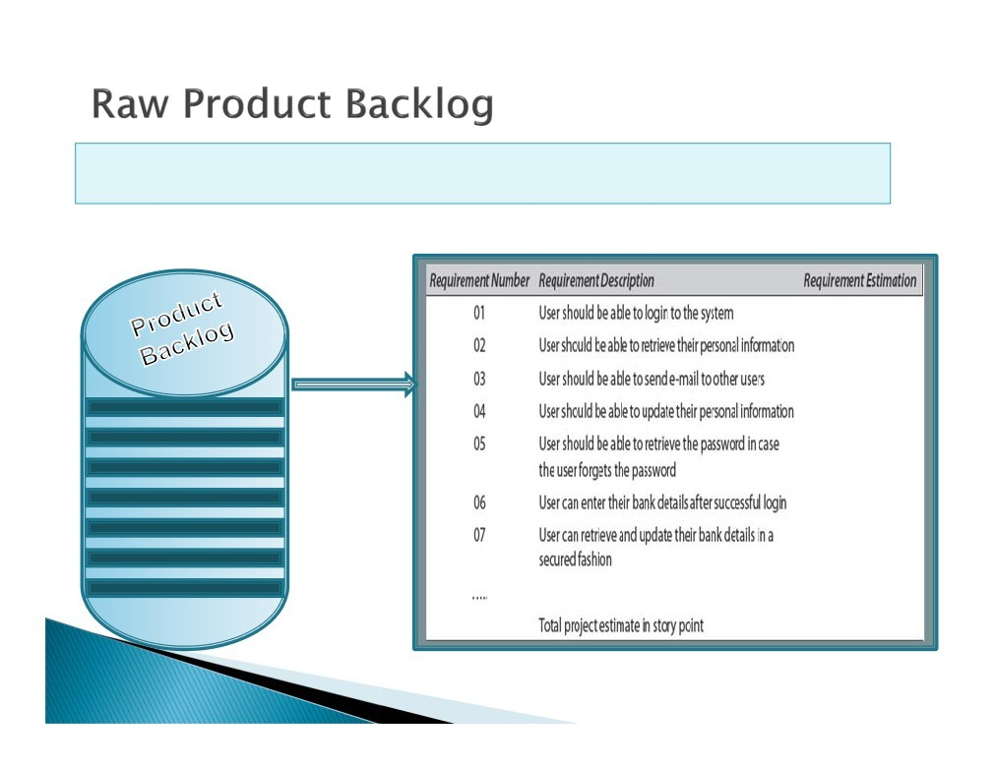
After going through all the activities of requirement gathering a Product Backlog is evolved which will be further refined and prioritized
01
02
03
04
05
06
07
(PMI®-ACP) Agile Certified
Practitioner

